Slide 1

Unit Testing in Software Engineering
Ensuring Code Quality at the Smallest Level

Slide 2


Introduction to Unit Testing
Software Testing Technique
Tests Individual Code Units
A fundamental practice in the software development lifecycle.
Focuses on isolating the smallest testable parts of an application.
Unit: Function, Method, Class
Checks Correctness of Logic
These are the atomic components that are individually verified.
Ensures each unit performs as designed under various conditions.

Slide 3

Why Unit Testing is Important
Early Bug Detection
Identifies defects at the development stage, preventing them from escalating.
Lower Fixing Cost
Bugs found early are significantly cheaper and easier to fix.
Improves Maintainability
Well-tested code is easier to refactor and maintain over time, reducing technical debt.
More Reliable Code
Increases confidence in the codebase, leading to more robust and stable applications.

Slide 4
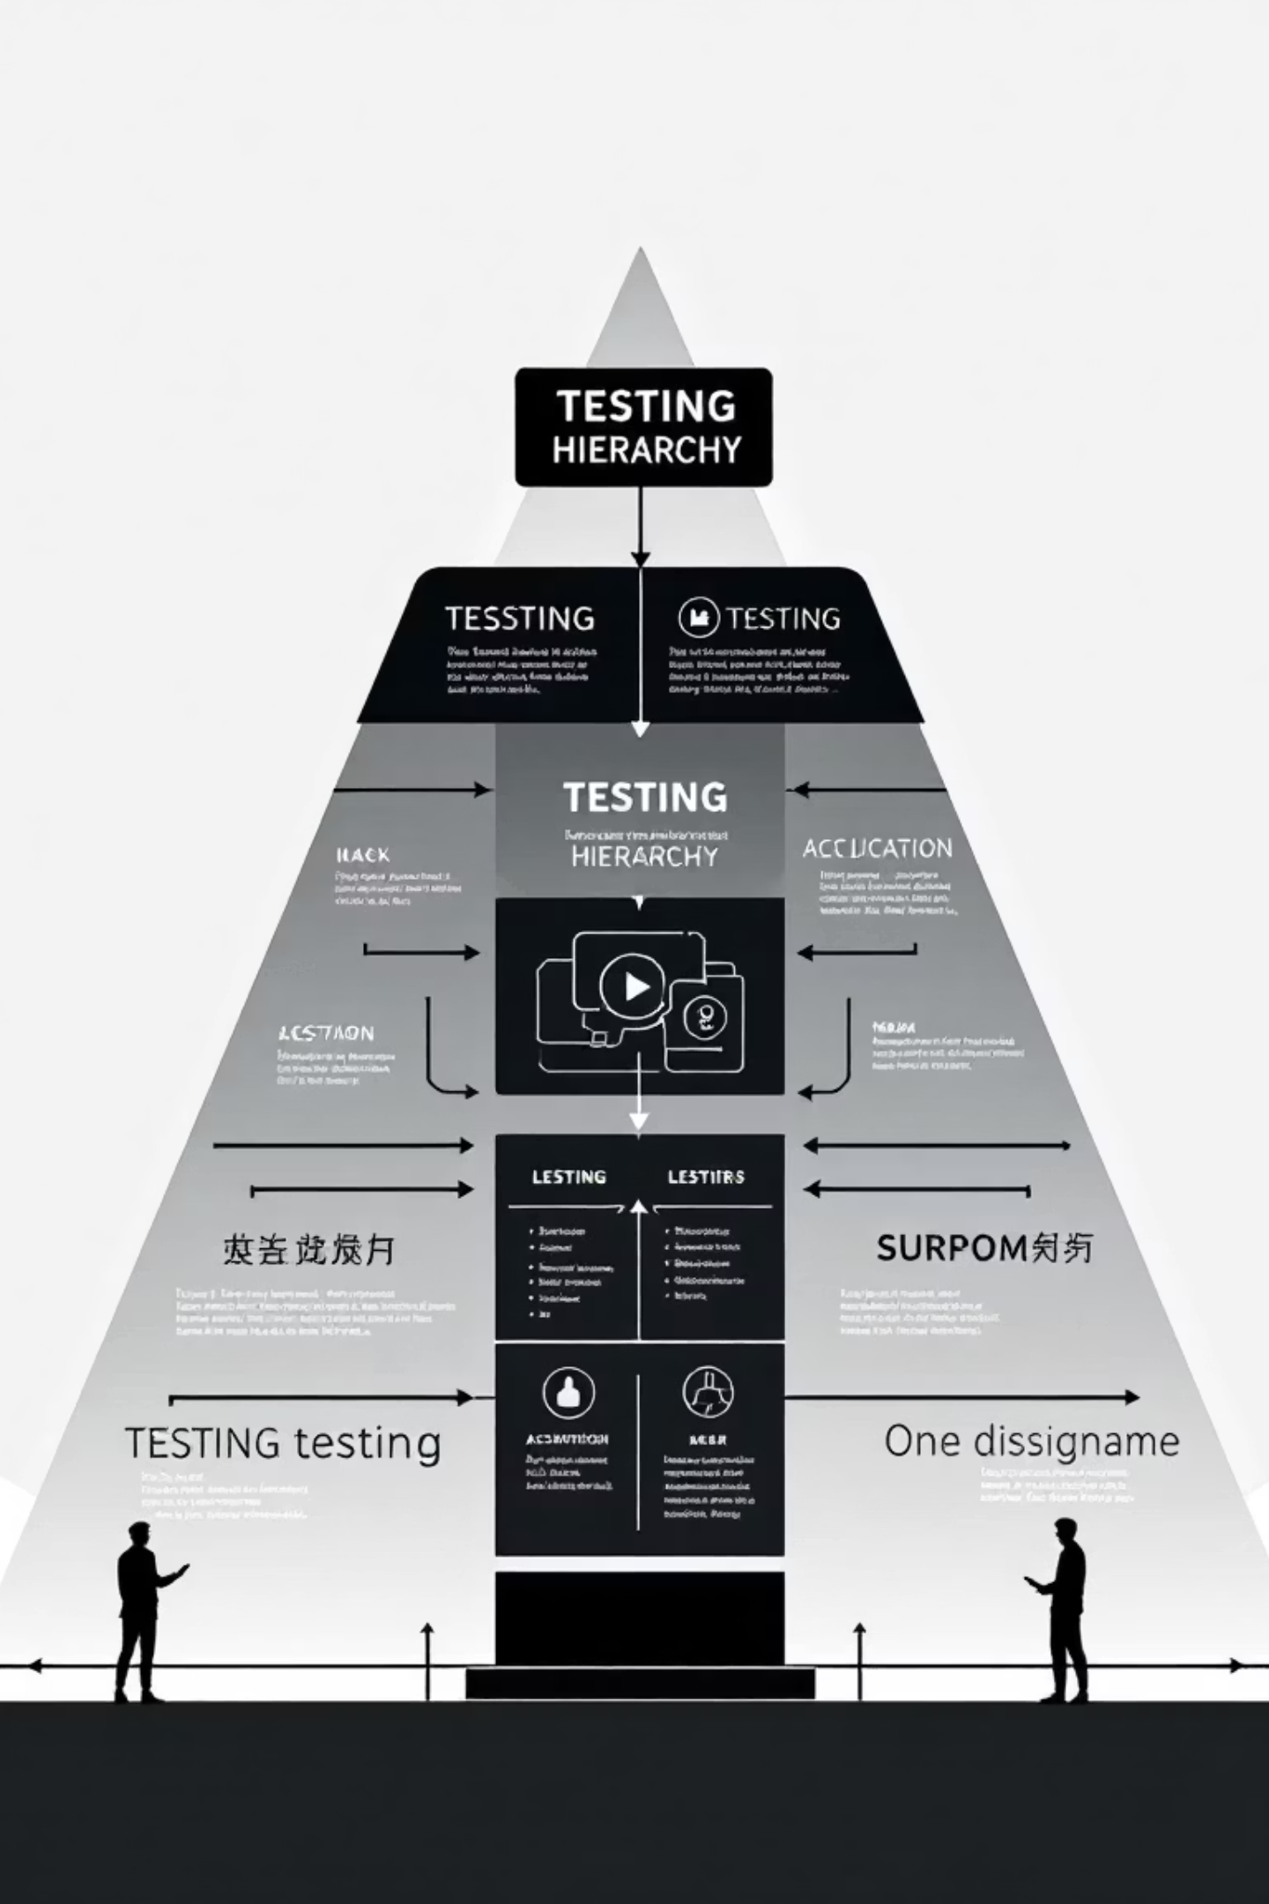
Unit Testing vs. Other Testing Types
Unit Testing
System Testing
Focuses on isolating and testing individual code components, such as functions or methods. Ensures that each small piece of code works correctly in isolation.
Evaluates the complete and integrated software product to ensure it meets specified requirements. Tests the entire system as a whole.
Integration Testing
Acceptance Testing
Verifies the interactions between different modules or components of an application. It ensures that integrated units work together seamlessly.
Determines if the system satisfies the user's requirements and business needs. Often performed by end-users or clients.

Slide 5

When Unit Testing is Performed
1
2
During Development Phase
Before Integration Testing
Tests are written concurrently with the code, guiding development.
Ensures individual units are sound before combining them, streamlining later stages.
3
4
Written by Developers
Executed Frequently
Developers understand the internal logic best, making them ideal authors of unit tests.
Run continuously, often with every code change, to provide immediate feedback.

Slide 6
Characteristics of Good Unit Tests
Fast Execution
Independent Tests
Repeatable Results
Should run quickly to allow frequent execution and rapid feedback.
Each test should run in isolation, without relying on other tests or external factors.
Consistently produce the same outcome every time they are run.
Easy to Understand
Single Responsibility
Clear and concise, making it easy to see what is being tested and why.
Each test should focus on verifying one specific piece of functionality or logic.

Slide 7


Manual vs. Automated Unit Testing
Manual Testing Challenges
Automated Testing Advantages
Time-consuming for repetitive tasks.
Executes tests rapidly, enabling frequent validation.
Highly susceptible to human error, leading to missed defects.
Provides consistent and reliable results without human fatigue.
Difficult to scale for large codebases or complex scenarios.
Scales effortlessly, covering extensive test suites in minimal time.

Slide 8

Popular Unit Testing Frameworks
Java
JUnit: The gold standard for Java unit testing, widely adopted and robust.
TestNG: A more powerful and flexible alternative to JUnit, supporting parallel testing.
Python
unittest: Python's built-in testing framework, inspired by JUnit.
pytest: A popular, feature-rich framework known for its simplicity and extensibility.
JavaScript
Jest: A delightful JavaScript testing framework with a focus on simplicity.
Mocha: A flexible, rich JavaScript test framework running on Node.js and in the browser.
C#
NUnit: A widely used, open-source unit testing framework for .NET languages.
MSTest: Microsoft's native unit testing framework integrated with Visual Studio.

Slide 9

Example: Unit Test using JUnit
Below is a simplified example demonstrating a basic unit test in Java using the JUnit framework.
import static org.junit.Assert.assertEquals; import org.junit.Test; public class CalculatorTest { @Test public void testAdd() { Calculator calculator = new Calculator(); int result = calculator.add(2, 3); assertEquals(5, result); } @Test public void testSubtract() { Calculator calculator = new Calculator(); int result = calculator.subtract(5, 2); assertEquals(3, result); } }
This example showcases the typical structure: setting up a test, executing the method under test, and asserting the expected outcome.

Slide 10
Unit Testing Process
01
02
03
Write Test Cases
Run Tests
Compare Results
Define expected behaviors and create tests to validate each unit of code.
Execute the suite of unit tests, ideally automatically after every code change.
Analyze test output to identify discrepancies between actual and expected outcomes.
04
05
Fix Bugs
Re-run Tests
Address any failures or defects discovered during the testing phase.
Verify that fixes have resolved the issues and haven't introduced new ones (regression testing).

